Slide 1
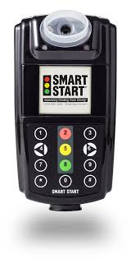
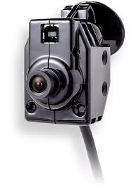


The Nuts & Bolts of Ignition Interlock…
Separating Drinking from Driving™

Slide 2

Smart Start, Inc.
Most experienced breath alcohol monitoring company in nation
Presence in 47 states & 16 countries
21+ years alcohol testing experience
Everyday more than 300 new people choose to do business with Smart Start
100,000+ current Smart Start customers
3.5 Years in North Carolina
27 Service Locations throughout the state
24/7 bilingual customer support
Industry leader in camera technology
Over 1 billion image downloads
Over 10k portable alcohol monitoring clients

Slide 3
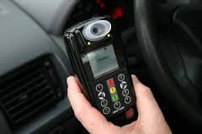
What is an Ignition Interlock?
  Referred to as IID or BAIID - a device that interrupts the ignition of a vehicle, ultimately preventing the vehicle from starting
  Similar to a breathalyzer or PBT that is utilized to determine a person’s breathe alcohol content, or BrAC level

Slide 4
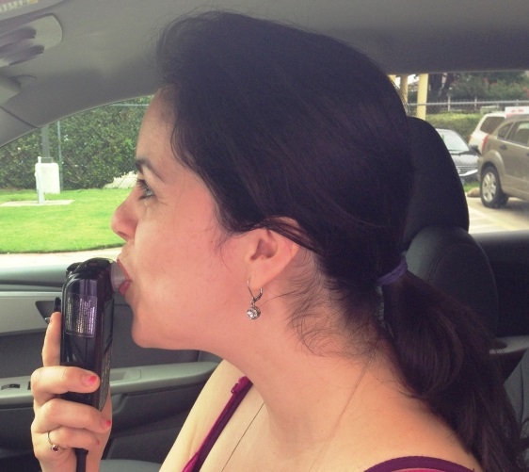
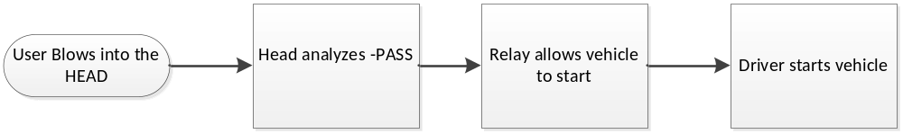
What is the Purpose of an Ignition Interlock?
  The IID’s objective is to determine whether or not the user providing the test contains alcohol in their system and if the sample is below a set-point. If so, then the vehicle is allowed to start.

Slide 5
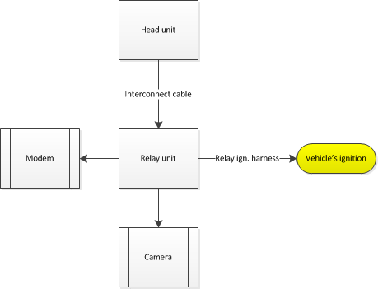
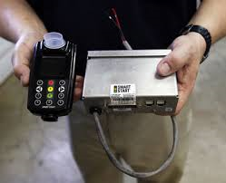


Components of an IID

Slide 6


The SSI 20/20 Ignition Interlock Model Specifications
Features | Specifications
Accuracy | +/- 0.002
Ambient Operating Temperature | -45°C to +85°C
Analysis Time | 3 to 7 seconds
Audio Prompts | Tones and/or voice prompts
Automatic Power Down | Programmable
BAC readout Format | Pass, Warn, Fail or 3 digit numeric value
Breath Sample | Deep Lung, Adjustable
Calibration | Alcohol Reference solution
Mouthpiece | Oval
Operating Voltage (system) | 12 to 24 VDC
Primary Display | Full color Graphic LCD
Range of Measurement | 0 to 1.00mg/L
Recycle (recovery) Time | 5 to 20 seconds
Secondary Display | Bi-color LEDs to indicate pass, fail, warn
Sensor | Quarter-size Electrochemical Fuel Cell
Dimensions | 4.75 x 2.5 x 1.75 in 12 x 6.5 x 4.5 mm
Specificity | Alcohol Specific
Weight | 148 grams

Slide 7
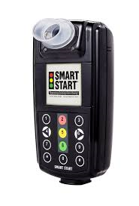

The SSI 20/30 Ignition Interlock Model Specifications
Features | Specifications
Accuracy | +/- 0.002
Ambient Operating Temperature | -45°C to +85°C
Analysis Time | 3 to 7 seconds
Audio Prompts | Tones and/or voice prompts
Automatic Power Down | Programmable
BAC readout Format | Pass, Warn, Fail or 3 digit numeric value
Breath Sample | Deep Lung, Adjustable
Calibration | Alcohol Reference solution
Mouthpiece | Oval
Operating Voltage (system) | 12 to 24 VDC
Primary Display | Full color Graphic LCD
Range of Measurement | 0 to 1.00mg/L
Recycle (recovery) Time | 5 to 20 seconds
Secondary Display | Bi-color LEDs to indicate pass, fail, warn
Sensor | Quarter-size Electrochemical Fuel Cell
Dimensions | 4.75 x 2.5 x 1.75 in 12 x 6.5 x 4.5 mm
Specificity | Alcohol Specific
Weight | 148 grams

Slide 8

SSI 20/20 & SSI 20/30 Units
  Fuel cell technology
  Optional GPS tracking
  Optional camera – positive ID
  SmartWeb® reporting (24/7 online access)
  24/7 bilingual customer care
  Multiple anti-circumvention features
  Remote unlock capabilities to extend service
  Numeric keypad for recall of appointment date & time
  Built in microchip records all test results, engine starts and stops, disconnections, and tampering for later review
  Meets all NHTSA, FCC, CENELEC, E-Mark and state requirements
  Made in the USA

Slide 9

Anti-Circumvention Features Anti-Circumvention Features
Pressure sensor – requirement - Face proximity
of hum tone - Humidity - Pressure
- IR temperature
- Breath temperature
Breath Sample/Blow Pattern Breath Sample/Blow Pattern
- Blow hum - Blow hum
- Straight hum - Straight hum
                - No hum
            - No hum requires additional anti-circumvention sensors to be enabled to meet NHTSA 2013 Standards
SSI 20/20 Unit SSI 20/30 Unit

Slide 10

IID Camera Overview
      IID with camera in 42 states
      Due to the success of the camera, over half of those states now require camera as standard equipment
      Supporting a growing international market
      10 million images from IID cameras are downloaded each month!!
      Smart Start Inc. is ISO 9001 certified company. ISO 9000 family addresses various aspects of quality management and contains some of ISO’s best known standards
      SSI products are 100% tested by our factoring partner prior to shipment and vehicle installation. Our Inbound Quality Assurance (QA) process ensures continued product quality

Slide 11
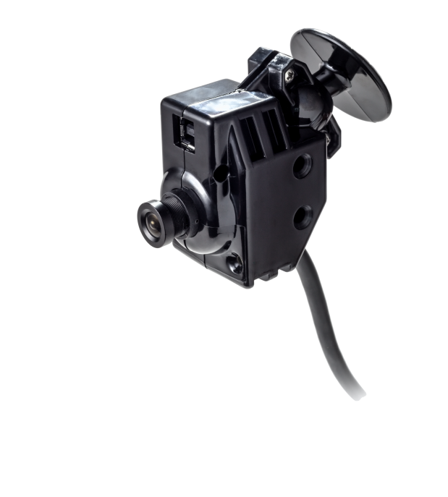

How Does It Work?
The camera captures images based upon commands sent by the IID unit. The commands are sent to the camera based upon ‘trigger’ events. These ‘trigger’ events, are configurable and primarily based upon local and state specific ignition interlock rules, regulations and/or program requirements.

Slide 12
Installation and Service
      The camera is affixed to the vehicle’s windshield using SSI approved double sided 3M adhesive usually above the registration sticker a few inches from the A-pillar. The design of the camera allows for the technician to adjust the angle of the camera while the camera is attached to the windshield. To ensure the camera is properly aligned, the technician will capture an alignment image. A client reference image is also captured during the service.
      When the client comes in for their regular calibration service, typically once every 30 days, the technician will service the IID via the IR dongle, downloading the data for the service period. Images are retrieved via the SSI USB cable to the USB port on the camera. The other end of the cable is attached to a communication port on the computer. When the download completes, all of the images for the service period will be removed from the camera, uploaded to a Smart Start secure server and subsequently made available on SmartWeb.

Slide 13
The New NHTSA Standards
On May 8, 2013 NHTSA published a new standard:
  Model Specifications for the Breath Alcohol Ignition Interlock Devices
The new specification became effective May 8, 2014
This is an updated standard from the last publication in 1992

Slide 14
NHTSA 2013 Standards
The most significant changes to 2013 NHTSA
  Warm-up time
    BAIID must be ready in 3 minutes at -40 C with input power
    BAIID must be ready to retest in 3 minutes after being turned on
  RFI/EMI
    SAE Surface Vehicle standard was adopted by NHTSA
    This is used to test BAIID electromagnetic immunity and compatibility
    Reduces electromagnetic emissions from the BAIID
    Enhances cell phone and CB usage, including “hot spots”
  Emergency Override test was eliminated
SSI Timeline to 2013 NHTSA Certification
  The SSI 20/30 completed testing at Element and PTI May 5, 2014
  The SSI 20/20 completed testing at PTI May 1, 2014 and Element July 7, 2014

Slide 15
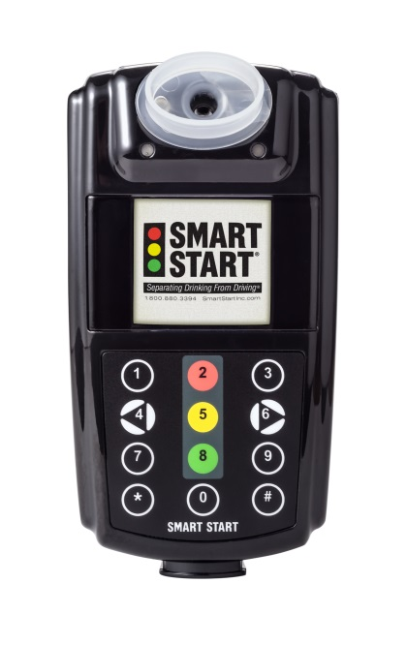
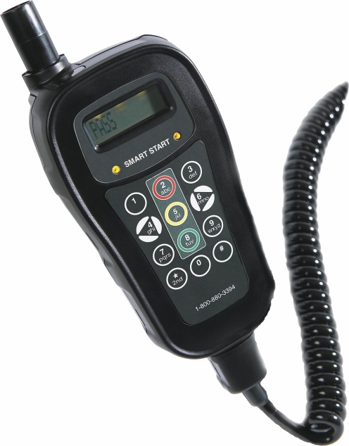
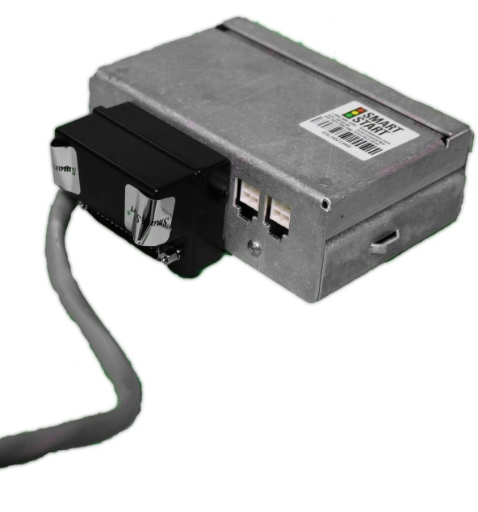
All product shipping out of Smart Start meets 2013 NHTSA standards certification
2030 – No Changes
2020 – with Heater
Relay2 - with RFI Module

Slide 16
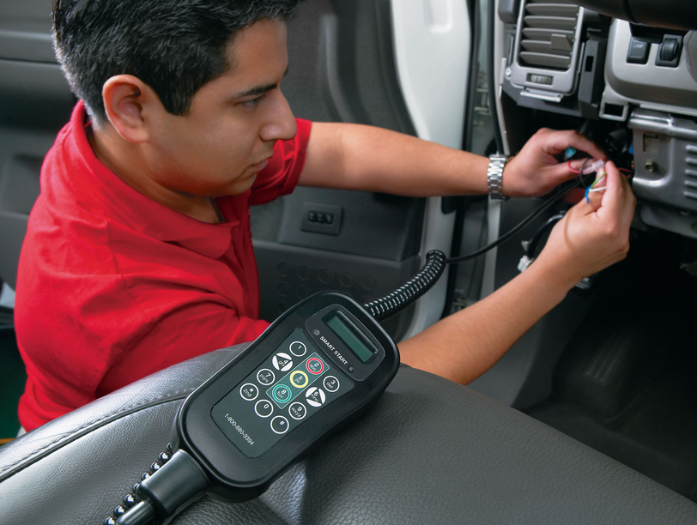
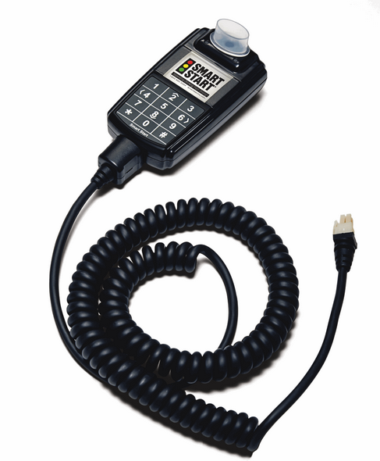
How an Ignition Interlock is Installed

Slide 17
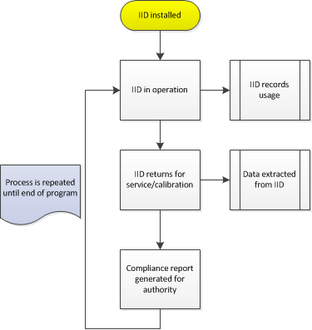

What to Expect…

Slide 18
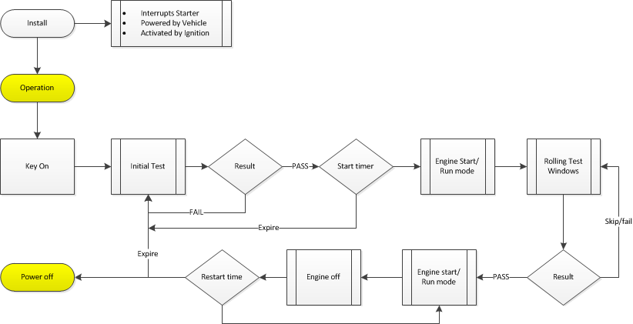

The Installation Process

Slide 19
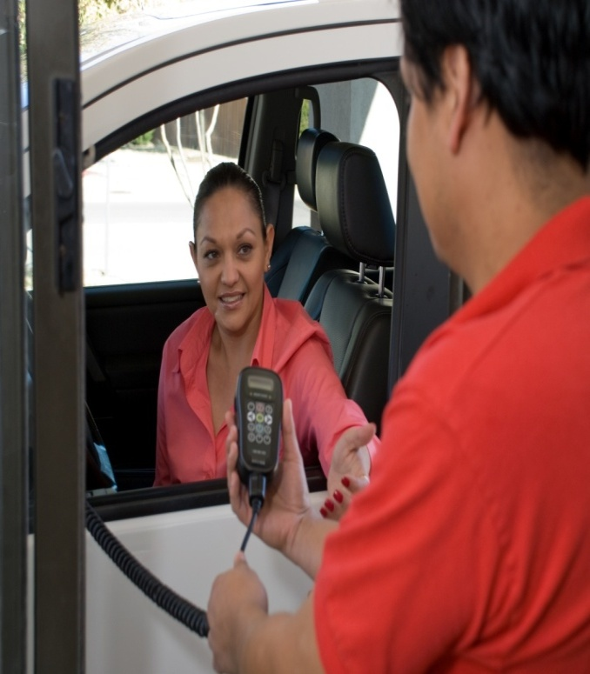

Monthly Service Process
Monthly the client visits a Smart Start facility to have their unit serviced
Service on average takes about 10 minutes
Service includes download of the device data, calibration of the IID and payment of lease
Data recorded by the IID goes through processing and generates a data report to be issued to the user’s monitoring authority which is the DMV in North Carolina

Slide 20
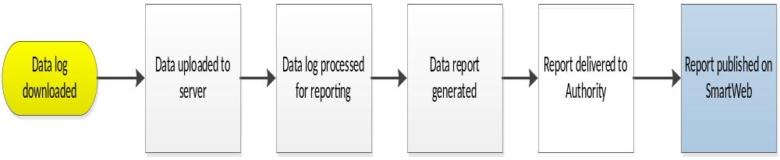
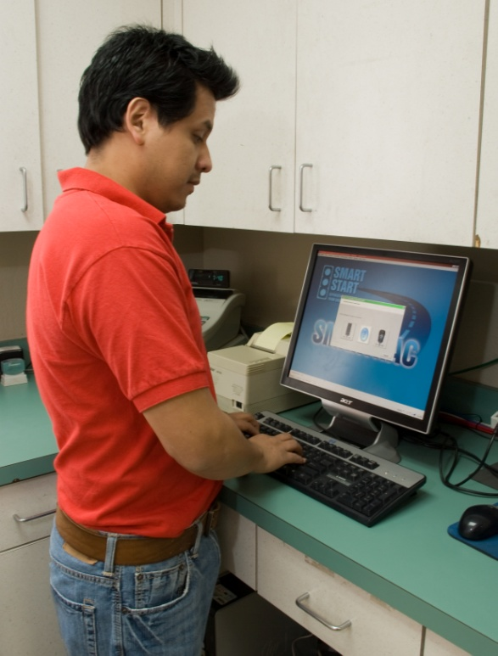
Monthly Service Procedure

Slide 21
How Does a Client Get Started
Call 1-800-880-3394 to schedule an installation appointment at most convenient NC location
Bring a copy of any paperwork specific to the client’s interlock requirements, proof of address and photo verification to the installation
Watch the training video & read through instructional information
Technician trains client on how to use the IID
Allow for about 1.5 hours for installation
Sign the lease, pay the monthly fee, schedule next month’s calibration, and the client is all set to go!

Slide 22
Smart Start Training Video

Slide 23
Types of Reports
Installation Notification
Non-Installation Notification
Events Summary
Log File
Removal
Lockout Notification
  Service
  Violation

Slide 24
SmartWeb Users’ Guide

Slide 25
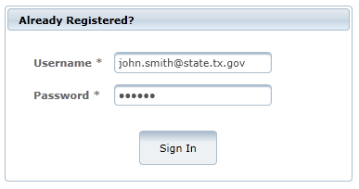
GETTING STARTED
SIGN In
Visit the website at https://smartweb.smartstartinc.com. Every user of the website needs to have a Username and Password to login to the site. The Username and Password are assigned during the monitoring authority setup process.

Slide 26
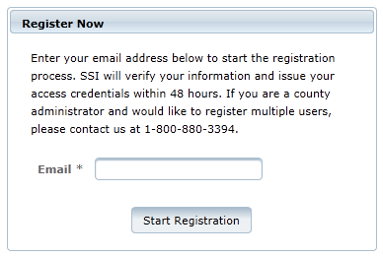
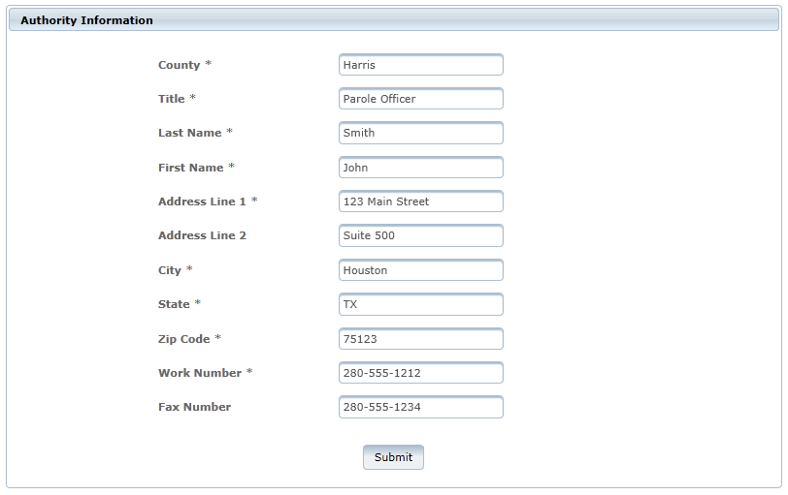
Register
Users can fill out the form below to request access to the site. An email will be sent to the admins for approval and account creation.

Slide 27
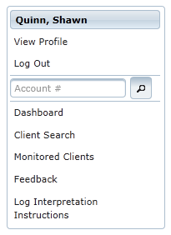
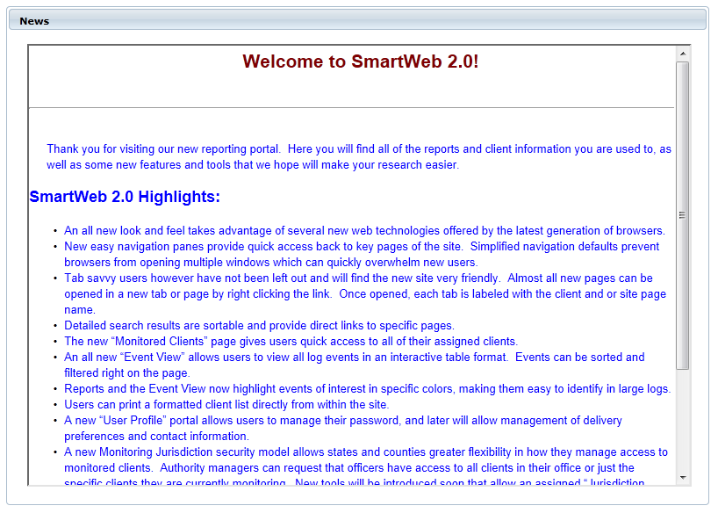
SmartWeb Welcome
Once the user logs in, the landing page will contain a dashboard, shortcuts and menu items. The Dashboard is a place holder for news and any information that Smart Start publishes to the users.

Slide 28
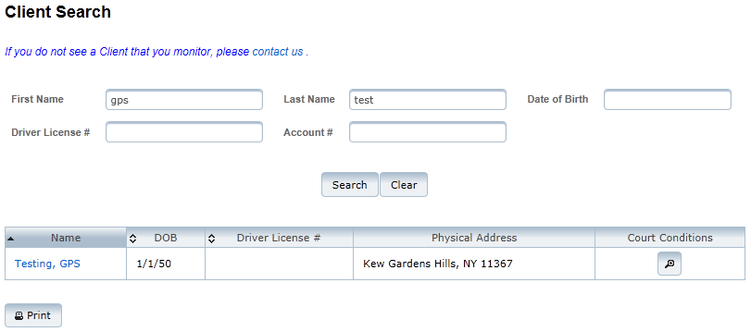

Client Search
Client search can be performed using one of the many options available. The results will contain a list of clients matching entered search criteria. The Client Search link is available on the list of menu items available on the left hand side.

Slide 29
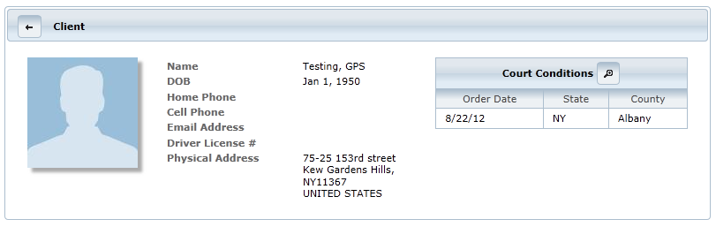
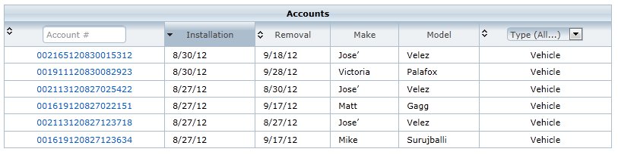
Client Accounts
Client selection will list client details and accounts.

Slide 30
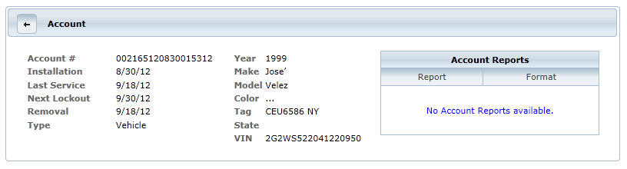
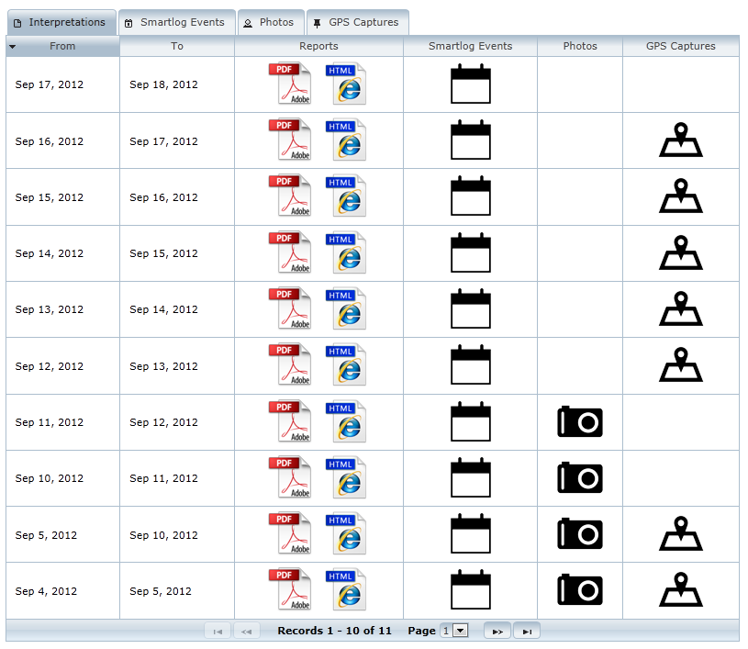
Account Details
The account detail page will contain information specific to the account, such as client information, vehicle information or IN-HOM information. This page also contains reports that are pertinent to that account as a whole.

Slide 31
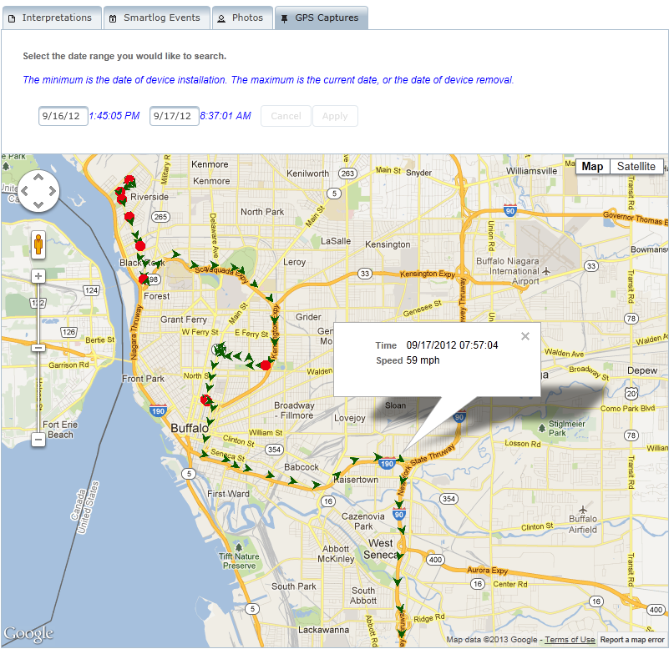
GPS
The user can navigate to this page by clicking on the GPS image from the Account Details page; here, the user can view GPS data for a specific date range, along with event data.
The user can also search for GPS data using date search fields. Clicking on a GPS point will give the location, speed, and timestamp. Selecting an event will also select the nearest GPS location. The map can also be viewed in full screen mode.

Slide 32
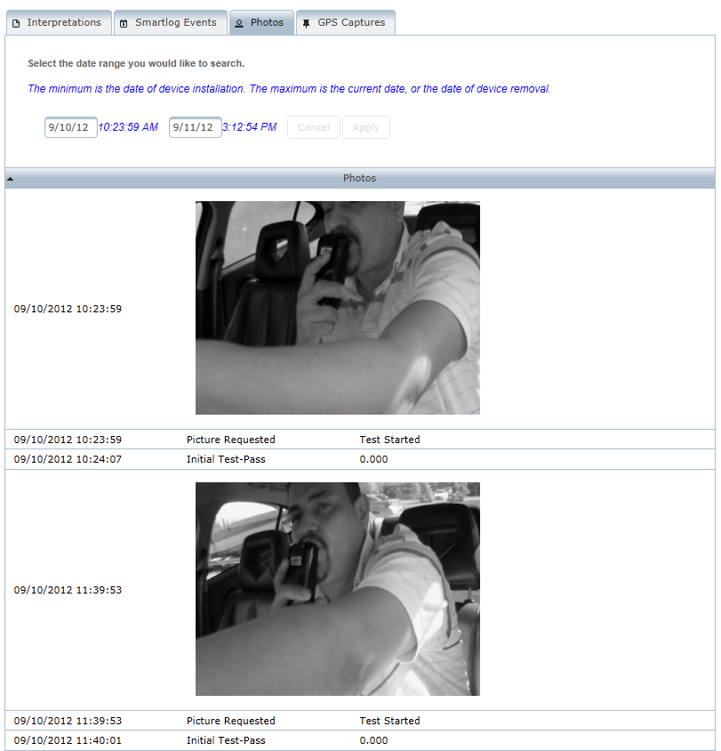
Photos
Photo page will contain Photos for a specific report, as well as the ability to search by date range. The page also contains client and account information.

Slide 33
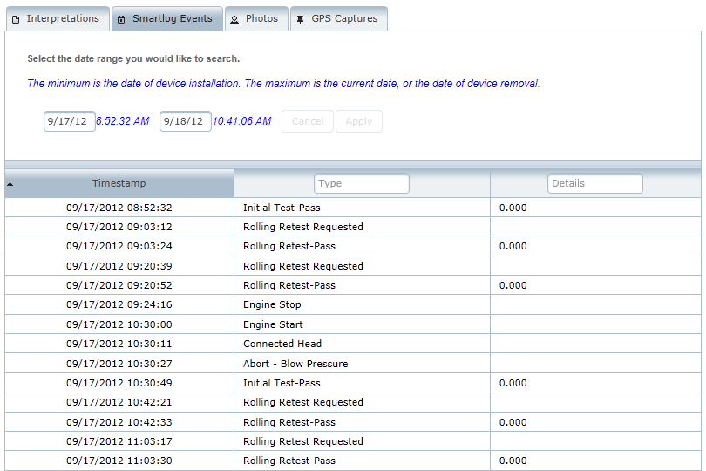
Event Information
The event information page contains the breakout of events for a particular date range; color-coded highlighting draws attention to events such as circumvention (in green), Skipped Rolling Retest (in blue), Warning (in yellow), and Violation (in red).

Slide 34
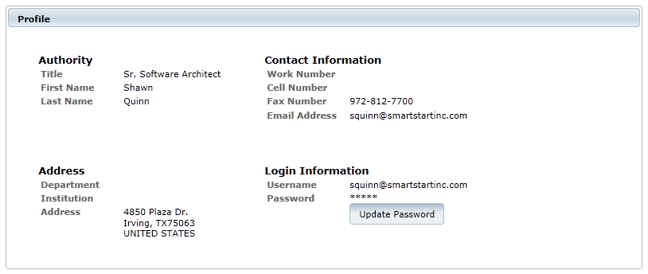
Authority Profile
Users can view their profile information – such as name, address, contact information, and login information – from the Authority Profile page.

Slide 35
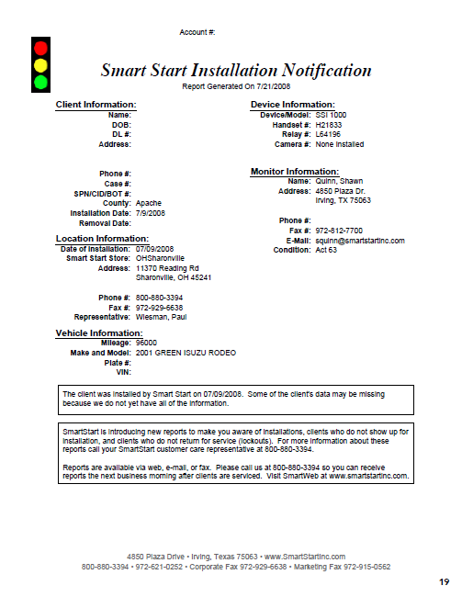

Slide 36
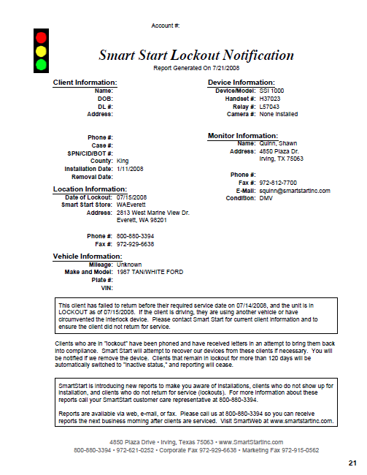

Slide 37
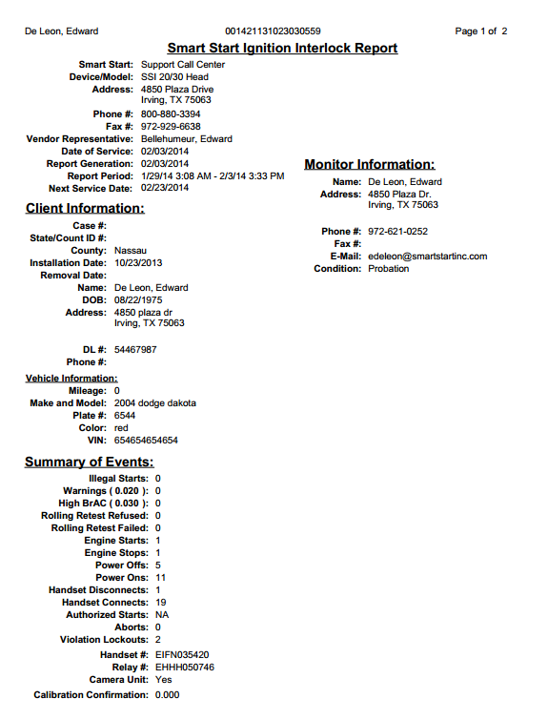
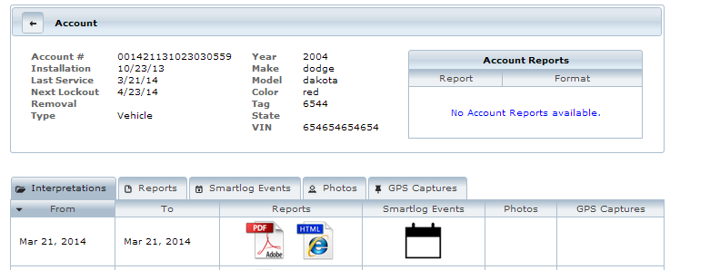
SmartWeb Reporting

Slide 38
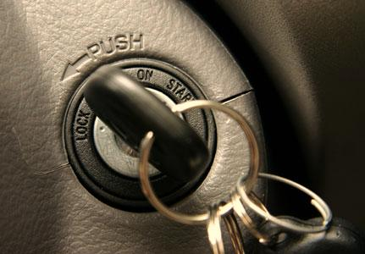
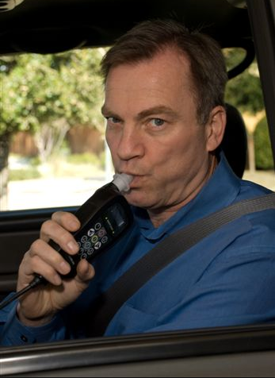
IID Terminology
Initial Test
initial test pass
initial test warn
initial test fail
Abort “blow harder” “blow softer”
How is this information used?
look for multiple failures over a period of time (3 or more over 15 min.) to validate CONSUMED alcohol

Slide 39
IID Terminology
Rolling Retest
skipped rolling retest (within 5 min.)
retests occur within 5 to 15 min. of starting car
retests occur randomly thereafter
How is this information used?
if you have a passing breath test shortly after a skipped test and no fails before starting the car, client did not intentionally skip the test
skipped retest/no subsequent tests are passed before turning engine off, client may be trying to avoid a failed reading
multiple failed retests over period of 15 minutes is a serious concern – drinking and driving!

Slide 40
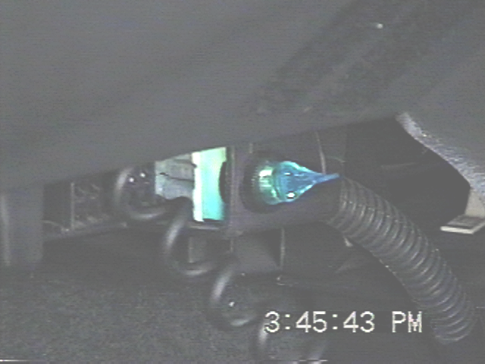

IID Terminology
Circumvention or Illegal Start
interlock detected engine is running but initial test – PASS was not provided within 4 minutes after device detected engine run
this requires the deliberate “bypassing” of the interlock wiring but can be accomplished by push starting a vehicle with manual transmission
How is this information used?
look for passing test within few minutes after start violation and then look for subsequent “retest” – PASS entries (used to check validity of circumvention)
if no subsequent passing breath tests & engine is not off for several minutes - indication circumvention is valid and client drove car for duration of time between circumvention and “engine off” event

Slide 41
IID Terminology
Power Fail
source of power was lost or disconnected (low vehicle battery voltage; tampering with power to device by disconnecting it; poor wire connection or short – detected with multiple power on/fails in short time span; blown fuse)
How is this information used?
power fails that last more than 60 minutes is cause for concern if log did not have “low battery” events preceding the power fail entry
if client is tampering by disconnecting device from power it usually is done more than once and for long periods of time
very short power disconnects of a minute or two should not be a concern

Slide 42
IID Terminology
Connected or Disconnected Head
not a violation or cause for concern
allowable for client to remove head at end of driving event and take head unit inside
How is this information used?
concern only when the head connects and disconnects and there is a pattern after engine starts w/o a head connect shortly after

Slide 43
IID Terminology
Violation Lockout
interlock pre-set with allowable number of violations based on state regulations
skips a test
fails a test
has illegal start or circumvention
How is this information used?
device enters a grace period before going into final lockout
displayed on client’s interlock screen
this entry does not mean client is in violation; look at all events that occurred to create lockout condition

Slide 44
What Causes a Violation?
Ignoring a rolling test – displayed as a “Missed Test”
Providing a sample on an initial or rolling test that is not a pass -displayed as a “FAIL” or “VIOL”
Bypassing the device by starting your vehicle without providing a passing test - displayed as a “START VIOL”
Disconnecting the handset unit from the curly cord while the engine is on

Slide 45
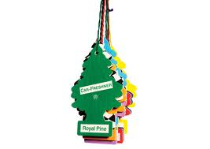

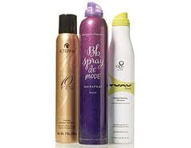
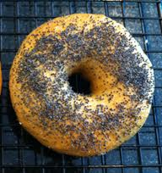

Environmental Alcohol – The Myths vs. The Truths
Environmental Alcohol
Mouthwash
Air fresheners
Hand sanitizer
Cologne
Foods & drinks
Dissipation Rate
Consumed vs. Environmental
Demo (with spray)

Slide 46
Elimination Rate of Alcohol
Average per Hour = .018
Usual Range = .015 - .022
More Weight = More Body Water = Lower BrAC
Gender Metabolism

Slide 47
NC State Regulations
Fail rate – 0.00 or 0.04
Positive or missed rolling retest – horn will blow & lights will flash continually until car is turned off
Lockouts – 5 minutes & 45 minutes
Violations – 4 days (96 hours)
Number of violations – one

Slide 48
Smart Start Fees
Installation fee - FREE
Month-to-month lease - $72.50
Transfer fee - $100
Removal fee - FREE

Slide 49
QUESTIONS & ANSWERS???
Contact Information:
Richard Adams, State Director
Richard.Adams@smartstartinc.com
Shelda Northcutt, Judicial Services Liaison
Shelda.Northcutt@smartstartinc.com
Jeff Sweemer, Operations Manager
Jeffrey.Sweemer@smartstartinc.com

